Slide 1
Using Relational Database?

Slide 2
Content
Database Design Best Practices
NoSQL

Slide 3
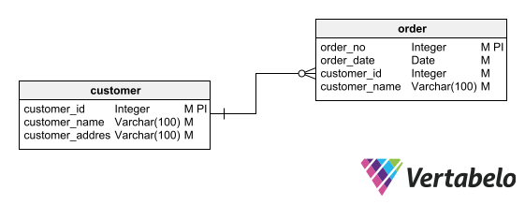
Database Design Best Practices
#1: Avoid Redundancy

Slide 4
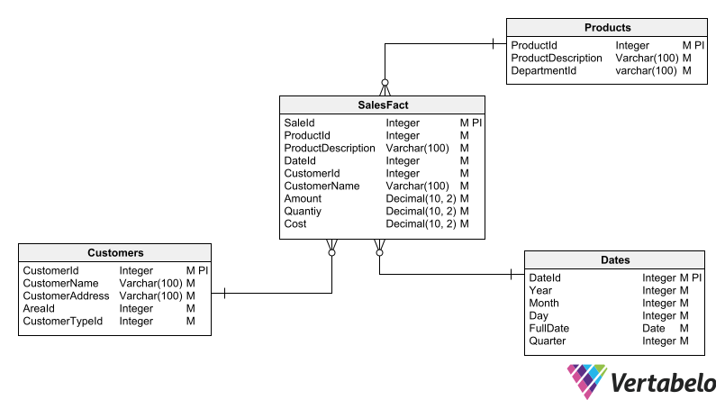
Database Design Best Practices
#1: Avoid Redundancy
An exception to the principle of non-redundancy occurs in dimensional schemas, which are used for analytical processing and data warehousing.

Slide 5
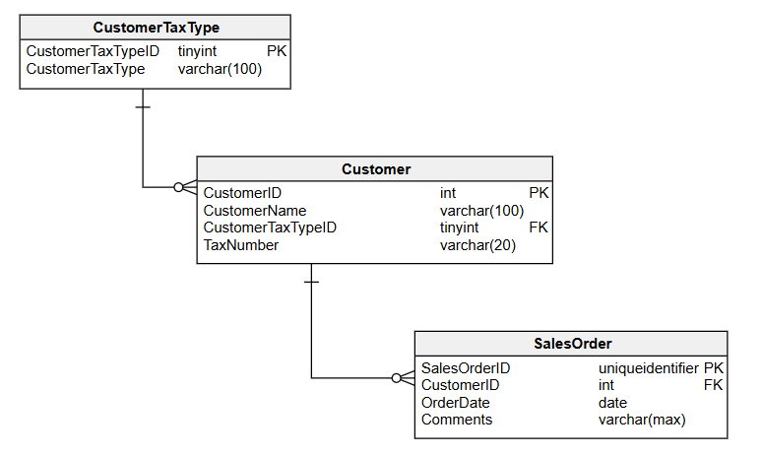
Database Design Best Practices
#2: Primary Keys and Unique Identifiers
Uniqueness
Stability
Irreducibility
Simplicity
Data type ?
Numeric (integer)
UUID/GUID

Slide 6
Database Design Best Practices
#3: Null Values
Use when the value of that column may be unknown, missing, or not applicable
Primary keys can never store null values.
A null value can be applied to columns of any data type (as long as the column supports null values).
Null values are ignored in unique and foreign key constraints.

Slide 7
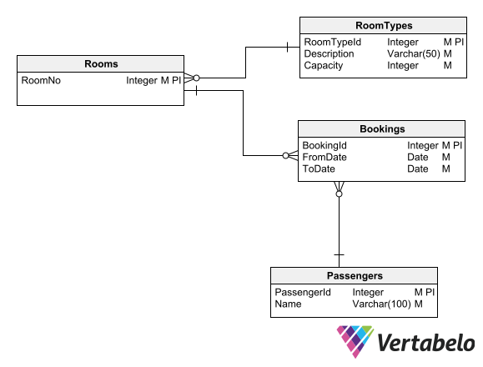
Database Design Best Practices
#4: Referential Integrity
By establishing relationships between tables using foreign keys and primary keys, we make use of the database engine’s resources to ensure data integrity.

Slide 8
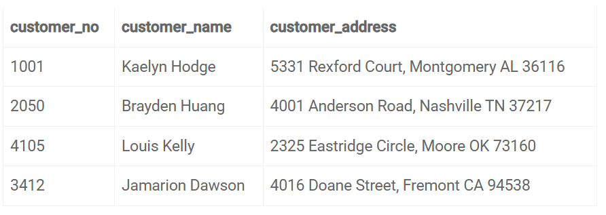
Database Design Best Practices
#5: Atomicity
If you combine more than one piece of information in one column, it will be difficult to access individual data later
Try to divide the information into logical parts

Slide 9
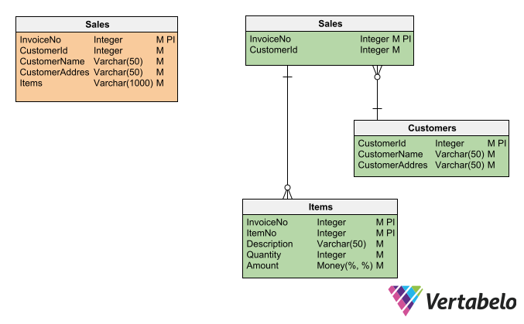
Database Design Best Practices
#6: Normalization
In practice, normalizing a model is a matter of bringing it to the third normal form (3NF). Bringing a data model to 3NF maintains data integrity, reduces redundancy, and optimizes the storage space occupied by the database.

Slide 10
Database Design Best Practices
#7: Data Typing
Choose a data type according to the nature and format of the information expected to be stored in that column
Ex: if you create a column to store dates, common database modeling tips suggest that the data type should be DATE, DATETIME, or TIMESTAMP. If you define this column as VARCHAR, dates can be stored in very different formats (e.g. '18-Jan-2023', '2023-01-18', '01/18/23'); it will be impossible to use this column as a search criterion or as a filter for queries.
The data type of a column must support the entire universe of possible data that can be assigned to that column, either by users or by applications
If you define the data type with less capacity than necessary, you will cause errors in the use of the database
If you define it with more capacity than necessary, you will be wasting storage space and opening the door to performance problems.

Slide 11
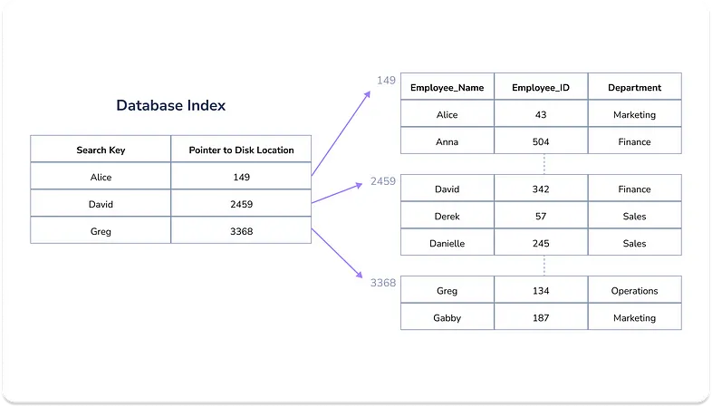
Database Design Best Practices
#8: Indexing
Indexes are data structures that make it easy for the database engine to locate the row(s) that meet a given search criteria
indexes are created mainly to speed up searches and queries

Slide 12
Database Design Best Practices
#8: Indexing
Some best practices:
Create an index for all tables’ primary keys (done automatically by RDBMS)
Create an index for each foreign key
Create indexes based on use cases
Analyze how the applications will use the database to anticipate the need for indexes that include the lookup columns detailed in those cases.
Create indexes for fields that are frequently used for querying or filtering data
Indexes take up storage space, so including very wide columns in an index will cause the index to take up a lot of space.

Slide 13
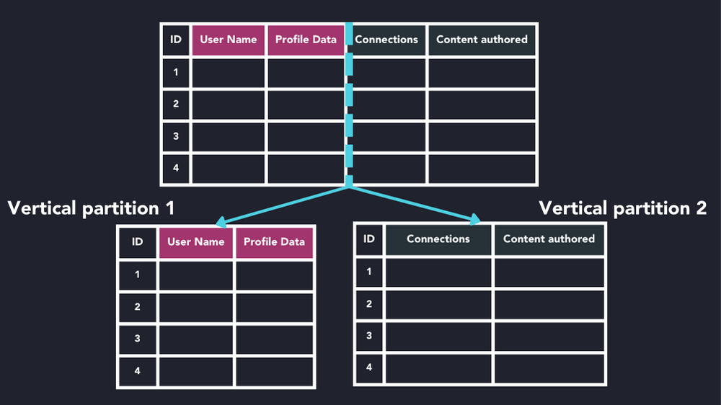
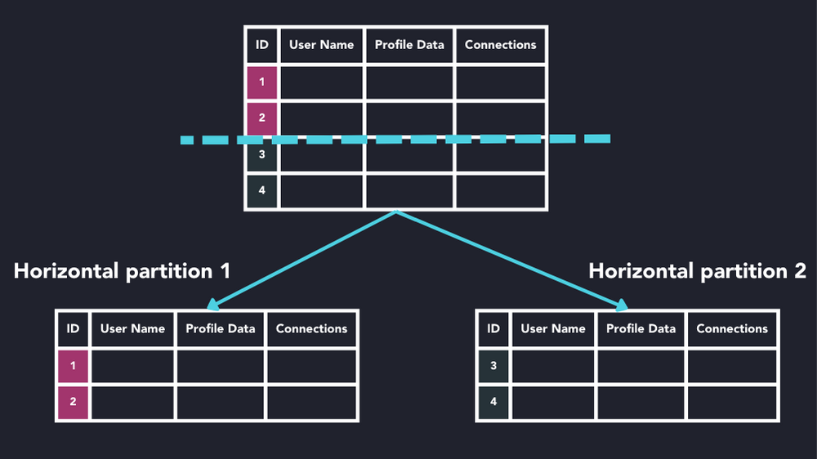
Database Design Best Practices
#9: Database Partitioning
Database partitioning (or data partitioning) is a technique used to split data in a large database into smaller chunks called partitions

Slide 14
Database Design Best Practices
#9: Database Partitioning
Horizontal partitioning
Range-based partitioning: data is split based on a range that does not overlap. The most common example is partitioning by time on time series workloads. Data can be partitioned by some time interval (e.g., daily, weekly, monthly) to aid range-based search.
List-based partitioning: data is split based on discrete sets of values, usually from a particular column. For example, a table containing sales data may be partitioned by geo-regions such as North America or Asia-Pacific regions. Partitions may be further split into subsections.
Hash-based partitioning: data is split based on some hashing algorithm. Hash-based partitioning applies a hash function to one or more columns to determine which partition to send the request to.

Slide 15
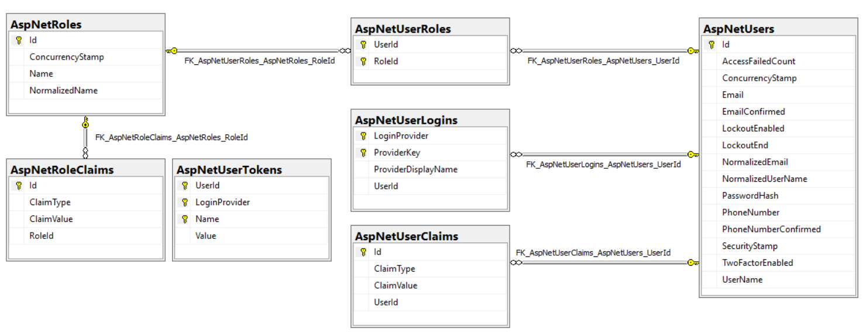
Database Design Best Practices
data lakes
#10: Authentication and Access Control
Controlling access to a system through user authentication is one of the most basic principles to prevent data misuse and promote information security.

Slide 16
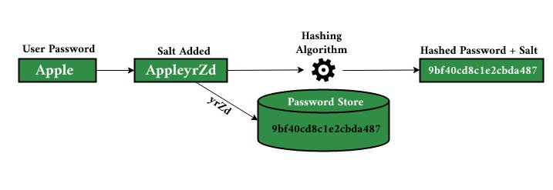
Database Design Best Practices
#11: Conceal Sensitive Information
Every database must be prepared to resist hacking and attempts to access data by unauthorized users.
Provide columns that support encrypted or hashed data.
Don’t Store Authentication Keys
Salted Password Hashing

Slide 17
Database Design Best Practices
#12: Something else?
Backup and Recovery
Strategies to ensure data can be restored in case of loss.
Ex: employs automated daily backups and provides options for manual backup to safeguard customer data against corruption or accidental deletion.
Query Optimization ?
Techniques to improve the efficiency of database queries?
Database Documentation
Comprehensive documentation of the database structure, design, and usage.
This aids both current and future developers in understanding the database design.
Scalability
The ability of a database to handle growth in data and concurrent users.
Ex: Netflix’s database architecture is designed to scale horizontally.
It uses microservices and databases like Cassandra that allow easy addition of nodes.

Slide 18
Content
Database Design Best Practices
NoSQL

Slide 19
NoSQL
https://drive.google.com/file/d/1TiBRciLgoaSxewpYwNgo2rTQ6G6yZ5OY/view?usp=sharing
https://www.mongodb.com/docs/manual/tutorial/model-embedded-many-to-many-relationships-between-documents/
https://www.geeksforgeeks.org/difference-between-sql-and-nosql/

